Slide 1
Risk Insight Analysis
This PBI model has been developed to support risk management activities and identification of data integrity issues
in ARM, enabling improved accuracy in risk reporting.
Model completed and in test phase, to validate data integrity and gain feedback to finalise release version.
Enhancements To Be Completed
Develop risk reporting dashboard to demonstrate contingency release.
Add hyperlink to PBI tables to enable direct link to ARM edit page.
Programme / Operational reporting functionality being developed.
Data warehouse currently being configured to include folder selection, which will enable specific folder to be referenced in PBI based on folder name i.e. Programme Level Risks Heritage, Programme Level Risks Data Centres. Portfolio Level Risk folder to be created and populated, this can then be referenced via PBI.
Operational Level Risks to be populated in top level folders for each area i.e. Finance, HSE, etc Management plan information currently not in the data warehouse, collaboration with David Brassington required to develop this data in the data warehouse.

Slide 2

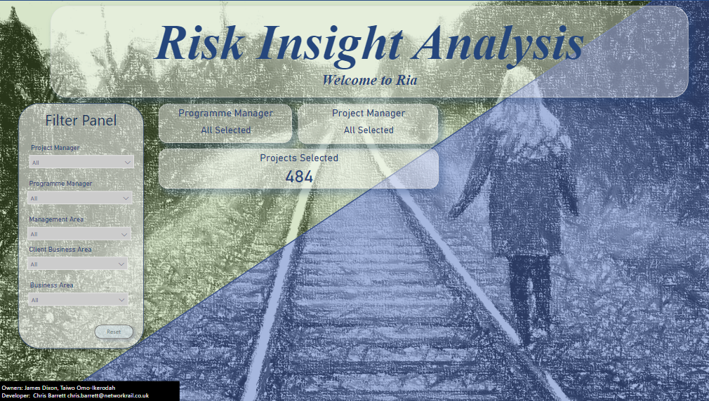



Ria Landing Page
Filter Panel
Any filters set here will filter the entire report by the chosen options.
Excluding the SLT dashboard.
Reset will set all values back to default.
Report Buttons
Open Filter Panel:
Opens a filter panel to change filter options.
Close Filter Panel:
Close filter panel / Info panel.
Info Pane Button:
Opens an information pane, providing
Some clarity on data & visual outputs.

Slide 3
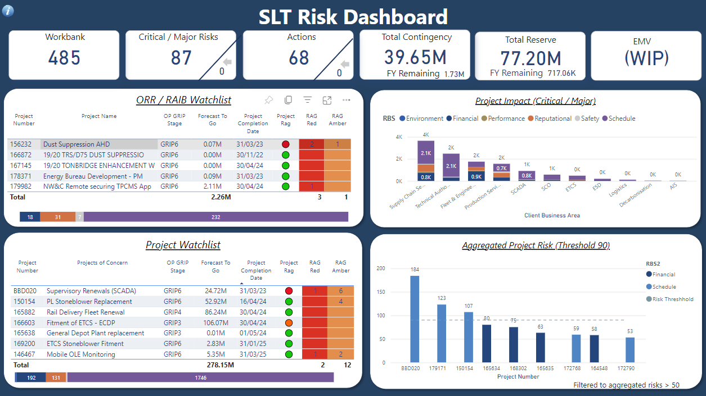
SLT Risk Dashboard
High Level Numbers
Report Panels
ORR RAIB Watchlist
Current rag status of ORR / RAIB related projects.
Including impact area assessment below.
Project Watchlist
Current risk status of projects identified as high profile.
Including impact area assessment below.
Project Impact
Project risk score categorised by impact area to support an
Improved understanding of areas of concern.
Aggregated Project Risk
Projects aggregated by impact area to support programme level
risk assessment.
Threshold identifies projects that require reporting at programme
level.

Slide 4
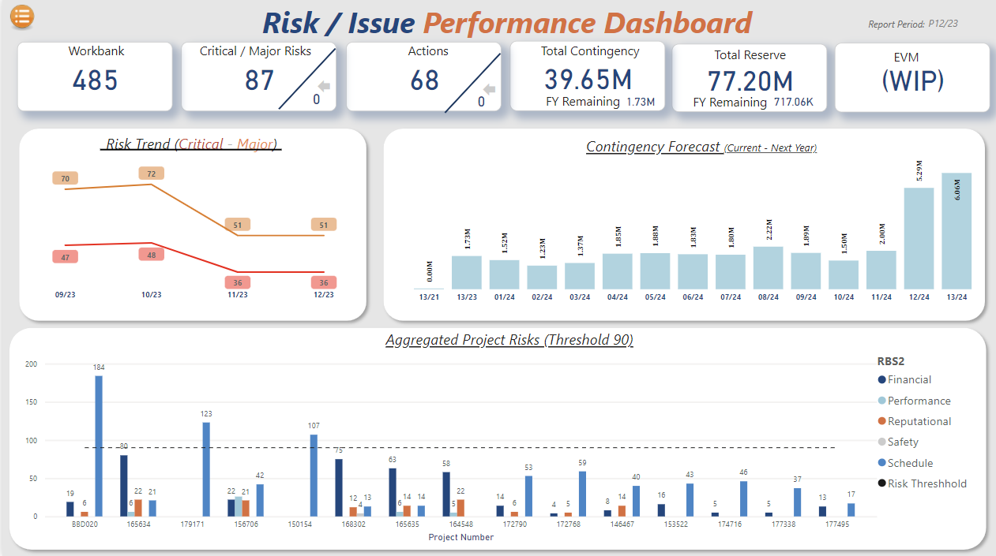
Data Reporting Period
High Level Numbers
Risk Trend: Provides periodic trend of project / programme uncertainty, highlighting increased / reduced risk uncertainty.
Contingency Forecast: 13 period view of forecast contingency spend, to support aggregated view of project uncertainty.
Aggregated Project Risk: Projects aggregated by impact area to support programme level risk assessment.
Aggregated total risks capped to reduce data in visual.
Threshold identifies projects that require reporting at programme
level.

Slide 5
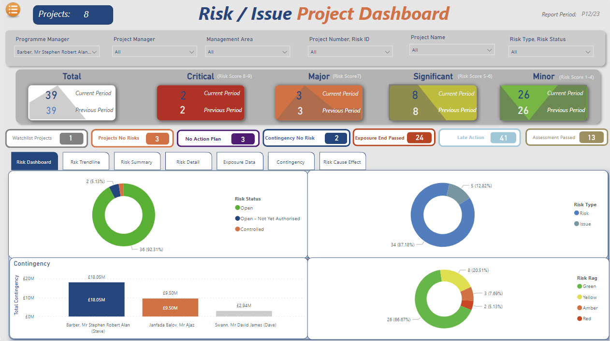
Risk Dashboard Tab
Page Filters
Risk Status
Report Measures
Watchlist Projects: Projects on watchlist
Project No Risks: Projects identified with no risks.
No Action Plan: Risks identified with no action plan.
Contingency No Risk: Contingency identified with no risks.
Exposure End Passed: Open risk exposure has lapsed.
Late Action: Action date has lapsed.
Assessment Passed: Assessment Date has lapsed.
Panels
Risks status: Percentage view of total filtered risks.
Risk Type: Percentage view of total filtered risks / Issues.
Contingency: Contingency by project.
Risk Rag: Percentage view of total filtered risks by rag status.

Slide 6
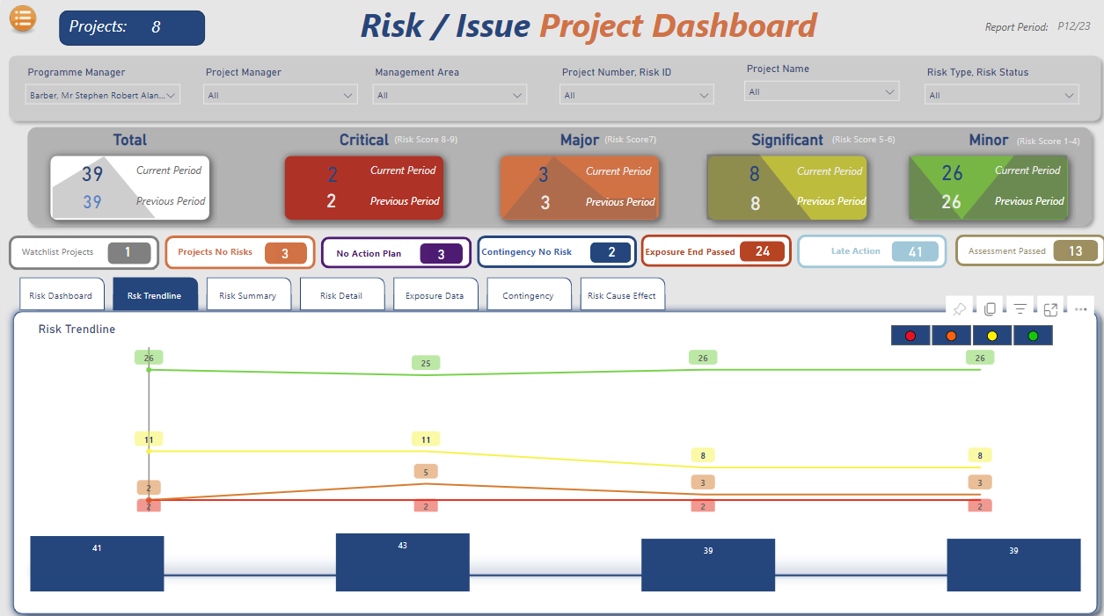
Risk Trendline Tab
Page Filters
Risk Status
Report Measures
Watchlist Projects: Projects on watchlist
Project No Risks: Projects identified with no risks.
No Action Plan: Risks identified with no action plan.
Contingency No Risk: Contingency identified with no risks.
Exposure End Passed: Open risk exposure has lapsed.
Late Action: Action date has lapsed.
Assessment Passed: Assessment Date has lapsed.
Panel
Risks Trendline: View of risk uncertainty trend

Slide 7
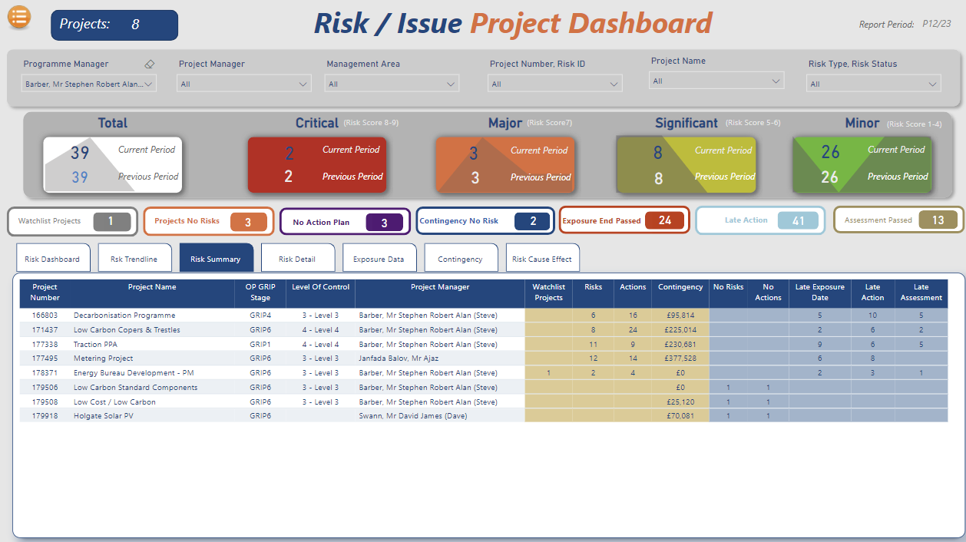
Risk Summary Tab
Page Filters
Risk Status
Report Measures
Watchlist Projects: Projects on watchlist
Project No Risks: Projects identified with no risks.
No Action Plan: Risks identified with no action plan.
Contingency No Risk: Contingency identified with no risks.
Exposure End Passed: Open risk exposure has lapsed.
Late Action: Action date has lapsed.
Assessment Passed: Assessment Date has lapsed.
Panel
Risk Summary: View of risk status and data quality by project.

Slide 8
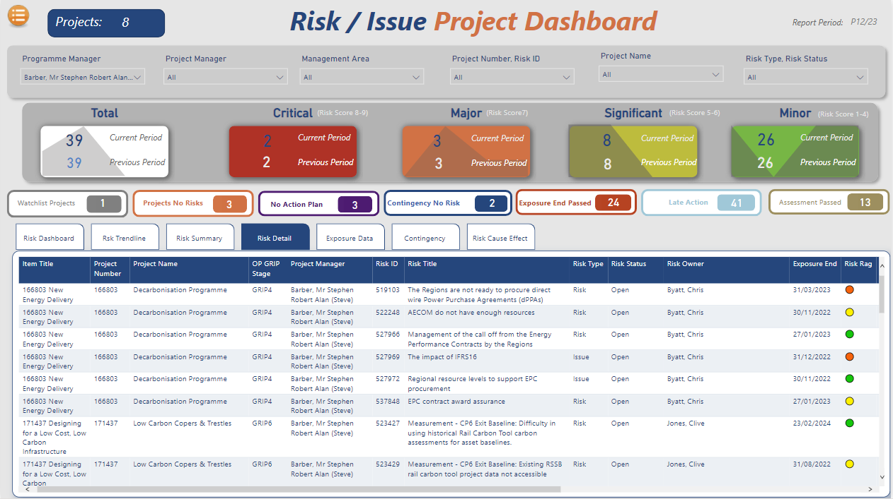
Risk Detail Tab
Page Filters
Risk Status
Report Measures
Watchlist Projects: Projects on watchlist
Project No Risks: Projects identified with no risks.
No Action Plan: Risks identified with no action plan.
Contingency No Risk: Contingency identified with no risks.
Exposure End Passed: Open risk exposure has lapsed.
Late Action: Action date has lapsed.
Assessment Passed: Assessment Date has lapsed.
Panel
Risk Detail: Detailed view of risk information.

Slide 9
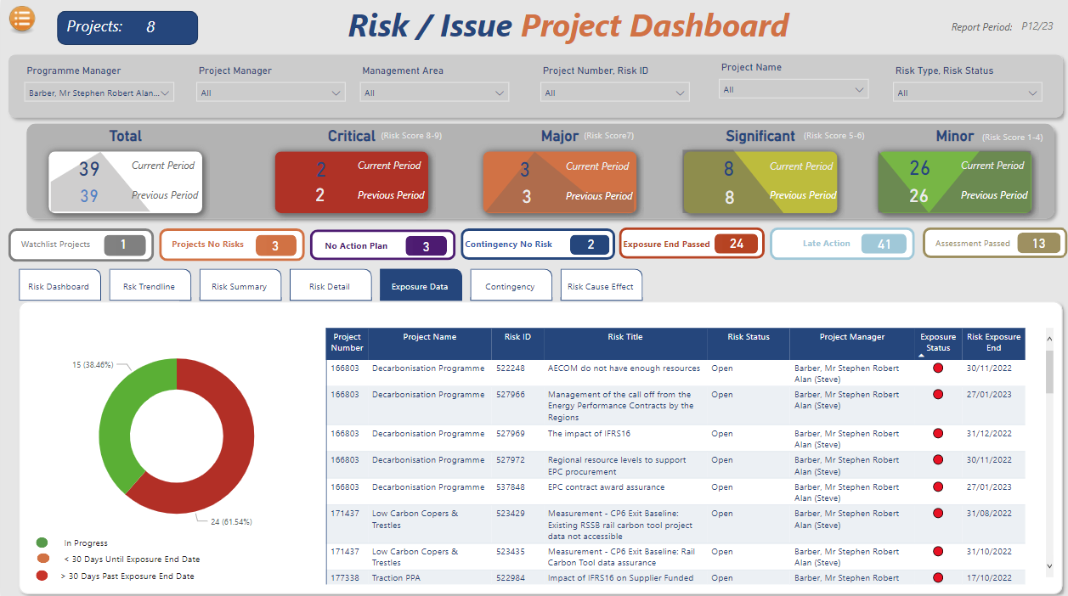
Exposure Data Tab
Page Filters
Risk Status
Report Measures
Watchlist Projects: Projects on watchlist
Project No Risks: Projects identified with no risks.
No Action Plan: Risks identified with no action plan.
Contingency No Risk: Contingency identified with no risks.
Exposure End Passed: Open risk exposure has lapsed.
Late Action: Action date has lapsed.
Assessment Passed: Assessment Date has lapsed.
Panel
Exposure Data: Detailed view of risk exposure information.

Slide 10
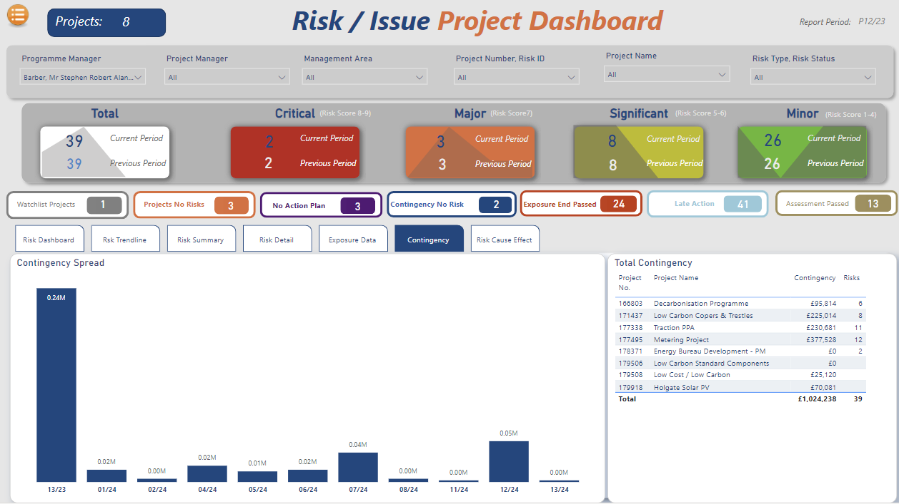
Contingency Tab
Page Filters
Risk Status
Report Measures
Watchlist Projects: Projects on watchlist
Project No Risks: Projects identified with no risks.
No Action Plan: Risks identified with no action plan.
Contingency No Risk: Contingency identified with no risks.
Exposure End Passed: Open risk exposure has lapsed.
Late Action: Action date has lapsed.
Assessment Passed: Assessment Date has lapsed.
Panel
Contingency: Contingency profile and detail regarding contingency alignment and contingency with no associated risks.

Slide 11
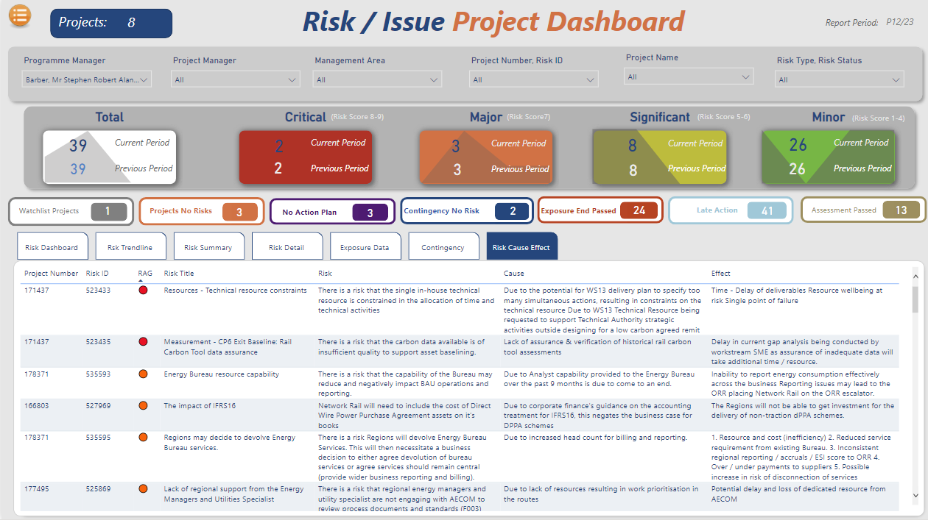
Risk Cause Effect Tab
Page Filters
Risk Status
Report Measures
Watchlist Projects: Projects on watchlist
Project No Risks: Projects identified with no risks.
No Action Plan: Risks identified with no action plan.
Contingency No Risk: Contingency identified with no risks.
Exposure End Passed: Open risk exposure has lapsed.
Late Action: Action date has lapsed.
Assessment Passed: Assessment Date has lapsed.
Panel
Risk Cause Effect: Detailed risk information to support assurance reviews.

Slide 12
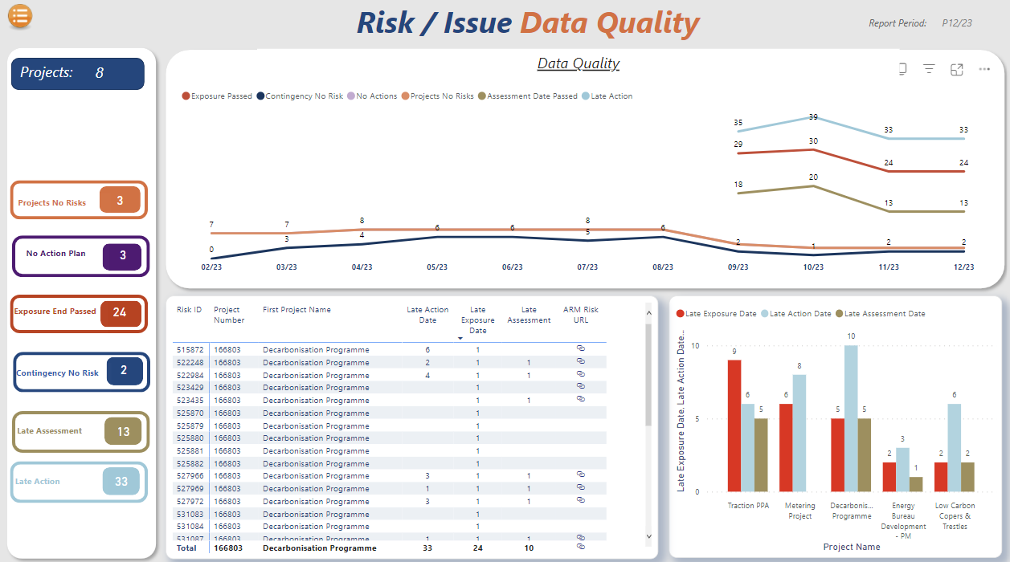
Risk Data Quality
Panels
Data Quality Trend Lines
1st line of defence on risk data quality assurance.
Data Quality By Project
Bar chart risk quality categorised by project
Risk Detail Information
Risk quality detail including hyperlink to ARM to support updates.

